Slide 1
Glands of the Endocrine System

Slide 2
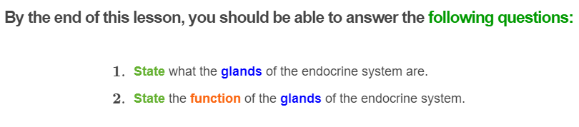
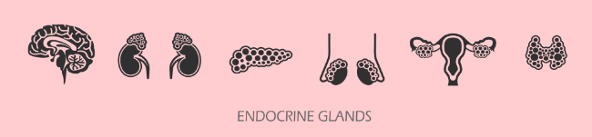

Slide 3
Let's quickly recap what a gland is!
A gland is a group of cells that produces and secretes (releases) chemicals.
The endocrine system is made up of endocrine glands, which produce and release hormones directly into the bloodstream where they can be transported to cells in other parts of the body to affect target cells.

Slide 4
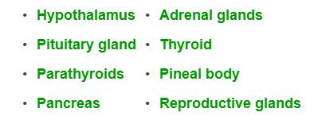
There are 8 major glands that make up the endocrine system.
This includes the:

Slide 5
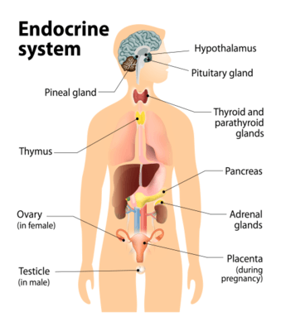
The below picture shows where each gland is located in the human body.

Slide 6
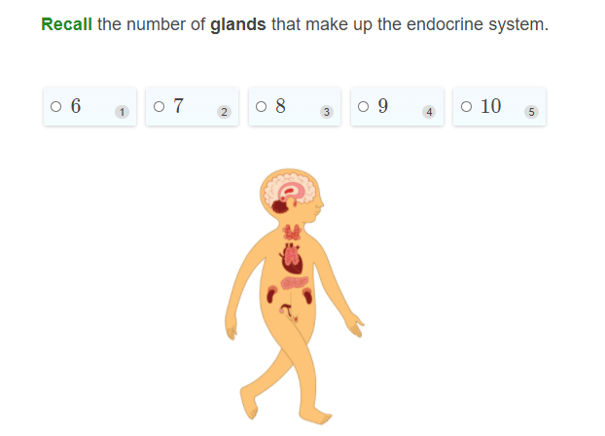

Slide 7
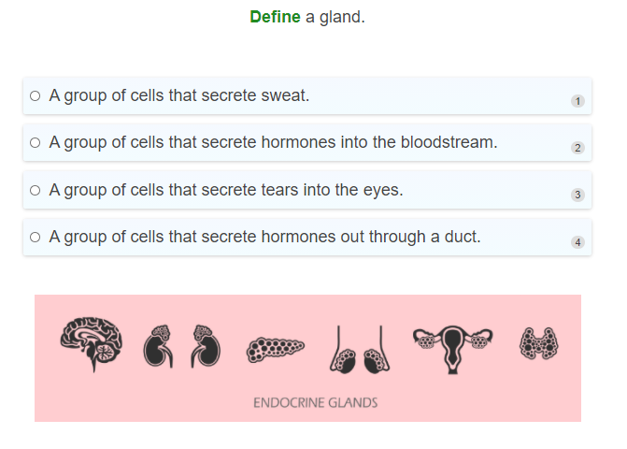

Slide 8
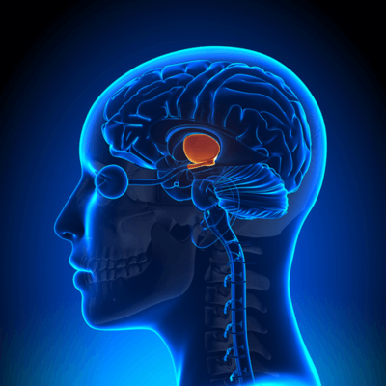
The hypothalamus is a collection of specialised cells located in the lower central part of the brain.
The hypothalamus acts like a bridge between the nervous system and the endocrine system.
It can receive and send out commands through the nervous system, and also produce hormones that interact with the endocrine system.

Slide 9
Function of the hypothalamus
The main function of the hypothalamus in the endocrine system is to tell the pituitary gland (which is located right underneath the hypothalamus) to start or stop producing hormones.
The hypothalamus is involved in controlling things like body temperature, thirst, hunger, mood and sexual development.

Slide 10
Pituitary gland
The pituitary gland is located at the base of the brain just beneath the hypothalamus and is commonly referred to as the 'master gland.'
This is because the pituitary gland controls many other endocrine glands. It does this by producing hormones which "tell" those glands to release their own hormones!
Hormones that are released by the pituitary gland control growth of bone and tissue, water balance (to make sure your body has enough water), and reproduction-related processes.

Slide 11

Pineal gland
The pineal gland is located near the center of your brain and is a small pine coned-shaped gland.
This gland produces the hormone melatonin, which is responsible for making you feel sleepy at night when it is dark and awake during the day when there is light.
Melatonin is only produced when there is low light, which is why you sometimes feel alert at night if you are exposed to bright light!

Slide 12
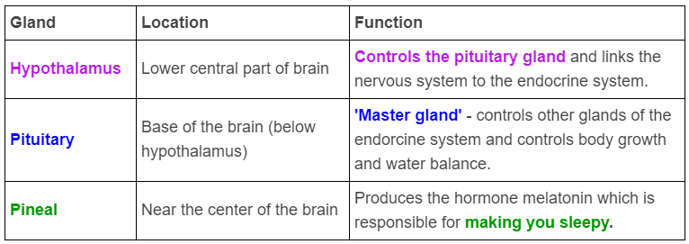
Let's summarise the endocrine glands we have learnt about so far!

Slide 13
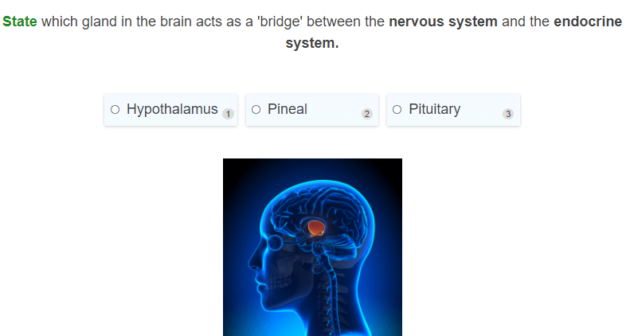

Slide 14
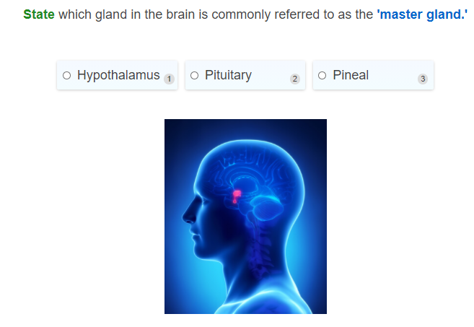

Slide 15
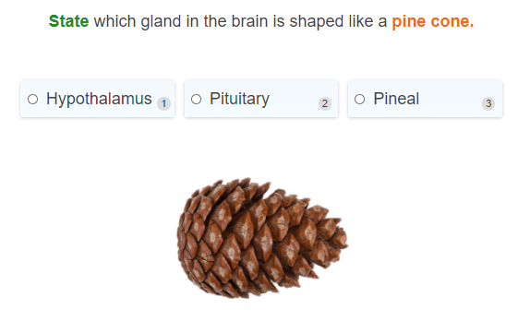

Slide 16
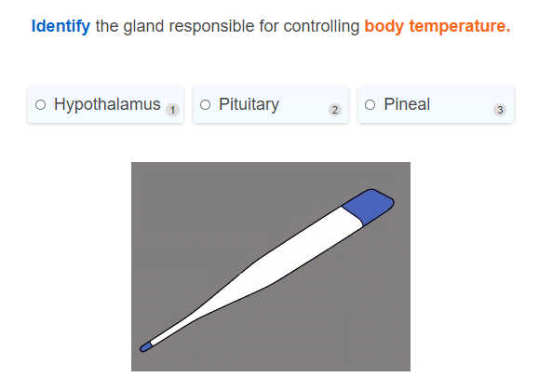

Slide 17
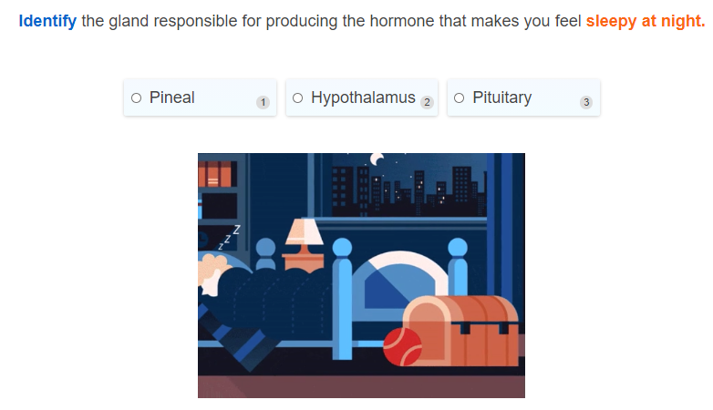

Slide 18
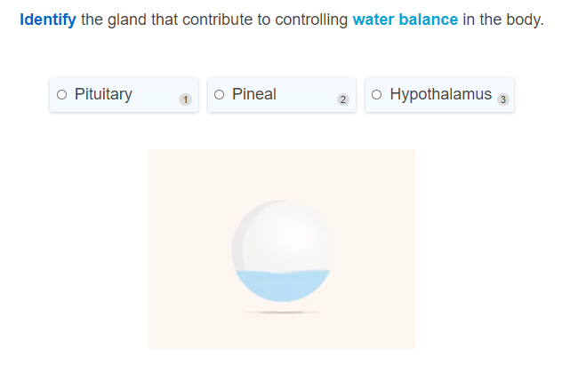

Slide 19

Thyroid gland
The thyroid gland is a butterfly-shaped gland which is found at the bottom of the throat.
The thyroid produces hormones which are essential for your body to be able to grow normally, and in the development of your brain and nervous system.
The thyroid also makes hormones that are important for metabolism (the process your cells go through to make energy for your body to use).

Slide 20

The Parathyroid Gland
The parathyroid gland is made up of four tiny masses of tissue that are found behind the thyroid. Each of the parathyroids are about the size of a grain of rice!
The parathyroid is responsible for maintaining calcium levels in your body, such as in the bones and in the blood.
This is important since your bones needs lots of calcium to stay strong! All the nerves in the nervous system also require calcium to transmit electrical impulses!

Slide 21
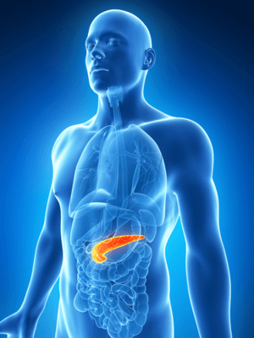
The Pancreas
The pancreas is a large gland that is found behind the stomach. The pancreas is a special gland since it is both an exocrine and endocrine gland at the same time!
It produces hormones through the endocrine part of the gland which make sure you have the right amount of sugar in your bloodstream.
At the same time, it can also produce digestive enzymes that break down the food you eat through the exocrine glands.

Slide 22
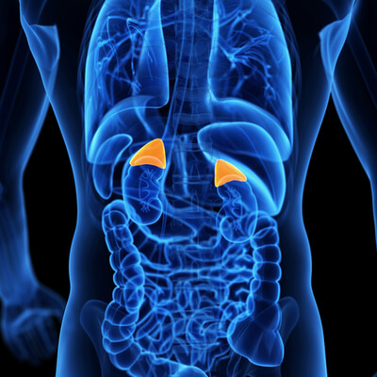
The Adrenal Glands
The adrenal glands are made up of triangular-shaped glands which sit on top of each kidney.
The main function of the adrenal glands is to regulate the body's metabolism and to maintain the balance of salt and water in the body which is important for maintaining your blood pressure.
The adrenal glands also make the hormone adrenaline which is produced in response to stress, fright, or attack.

Slide 23
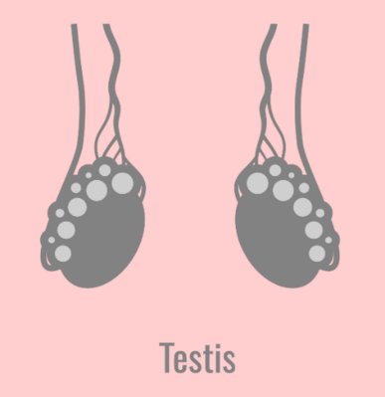
Reproductive Glands
The reproductive glands are the testes in males and the ovaries in females. These glands produce sex hormones when you reach puberty.
The testes are found in the scrotum and produce the hormone testosterone, which is responsible for the growth and development of the sex organs, body hair, bones, muscles and deepening of the voice.

Slide 24
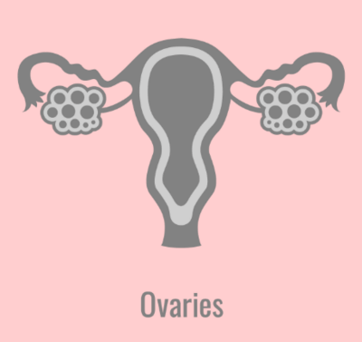
The Female Reproductive Glands
The ovaries are found in the lower belly (just beneath the belly button) and produces the hormones oestrogen and progesterone.
These hormones are responsible for growth and development of the breasts, bones and the uterus/womb (to prepare the body for pregnancy.)

Slide 25
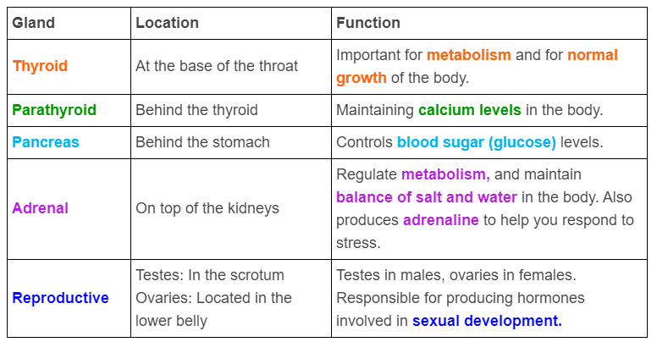
The table below summarises the endocrine glands we have learnt in this section.

Slide 26
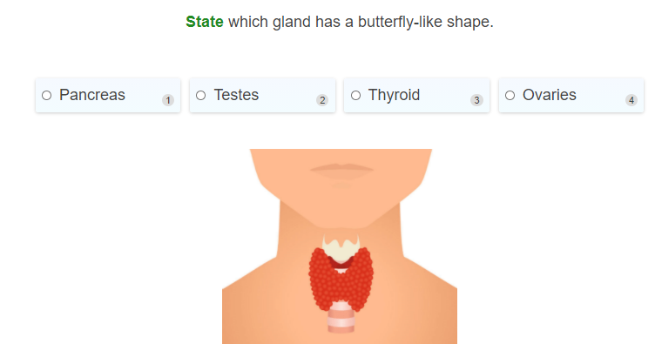

Slide 27
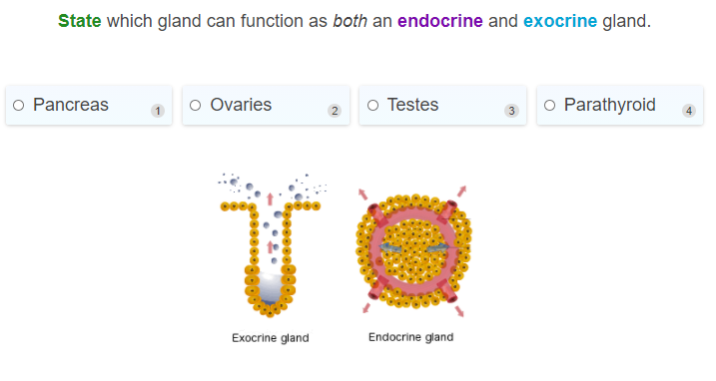

Slide 28
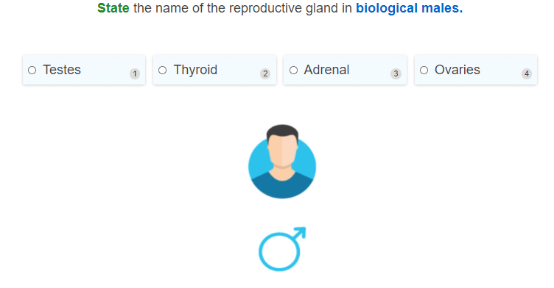

Slide 29
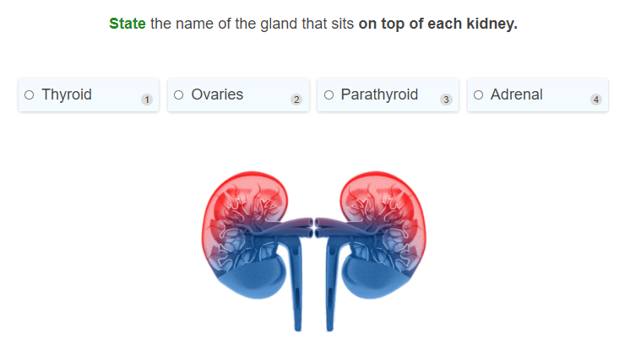

Slide 30
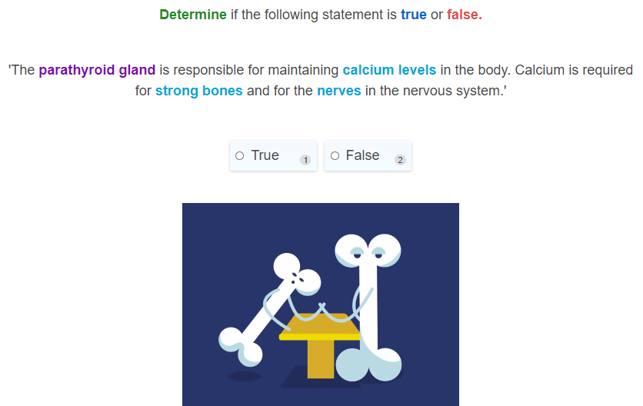

Slide 31
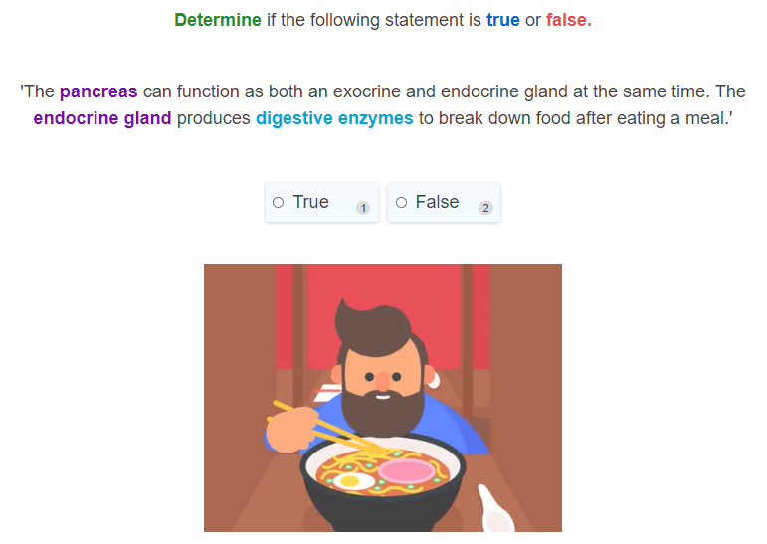

Slide 32
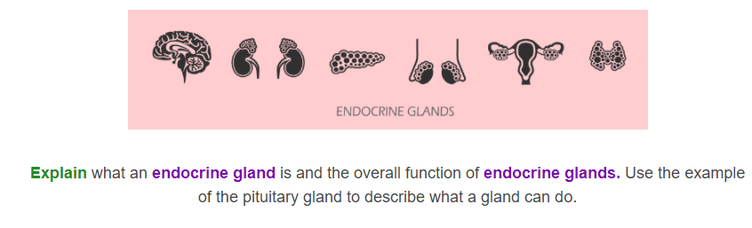

Slide 33
